Slide 1
J&L Coffee Inc
Mace Network Security Services
Presenter: Alice Mace
Notes:
Greeting
Self & company introduction
Background: Selected as a consultant to design a secure network for J&L Coffee
Purpose: Review the findings and recommendations for a more secure network

Slide 2
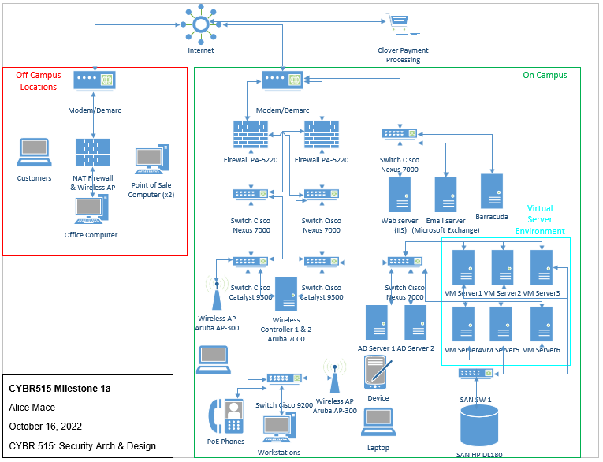
Current System Architecture
Notes:
This is the current architecture and is the baseline for all other content covered in this presentation
There are several vulnerabilities associated with this hardware set up, but many other associated with current policies and procedures that we’ll discuss next.

Slide 3
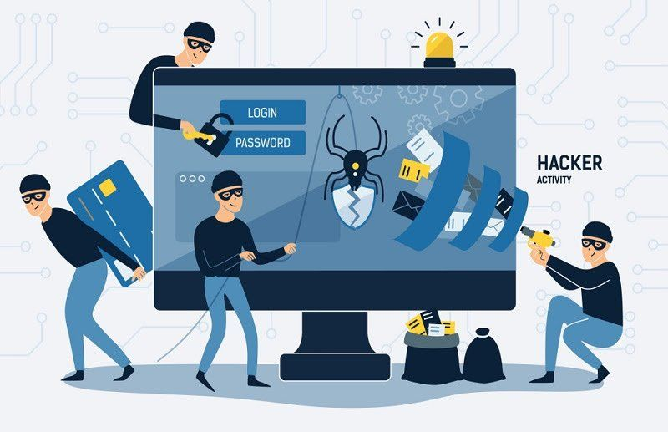
Potential Vulnerabilities
Point of Sale Computers
Clover Payment Processing
Firewalls
Active Directory
Updating Programs
Wireless Access Points
Physical Access
Email
Virtual Servers
Storage Area Network
Notes:
Point of Sale Computers
There are two point of sale computers that connect to the firewall and use the internet to connect to the corporate headquarters using a VPN to process payments. A vulnerability was created by allowing the point-of-sale software to be minimized, which resulted in those computers getting malware.
A vulnerability was also created by allowing the point-of-sale software to be minimized, which resulted in those computers getting malware.
Nothing preventing the point of sale computers from sharing the same login/connection point as the customers at these sites
Clover Payment Processing
Connected to, both on and off-campus locations is the Clover Payment Processing that connects via J&L’s internet to Clover’s servers. These servers are cloud based and, since not owned by J&L, cannot be controlled or configured with their security parameters.
Firewalls
The current configuration of the firewall is to allow all traffic in both directions, making them ineffective.
The web and email servers do not have firewalls on the external connections, allowing anything to be sent out.
Active Directory
The Active Directory domain controllers were configured using default settings and the password history and complexity requirements were disabled. They also only have one that services the entire campus, creating a single point of failure.
Another active directory controls the Chief Financial Officer for the Accounting and Finance Group, but allows all administrative assistants administrative privileges. This creates additional instances that the active directory could be misused or infiltrated.
Updating Programs
There is no standard process for updating programs on the workstations except for WSUS to update Microsoft applications. Approximately one third of employees have administrator access on the workstations to run and install new applications. This can cause multiple configuration problems and lead to unapproved software being downloaded.
About 1/3 of employees have local administrator access for the +400 workstations in order to install and run applications. This large group makes it more likely for someone to install or configure something harmful to the network, intentionally or unintentionally.
A security policy should also detail how and when program updates, patches, or upgrades will be installed by the IT group/system administrators. This policy should also address how passwords should be handled, as a huge vulnerability currently is employees writing down their passwords and keeping it at their desk
WAP
The access points are AP-300’s and there are over 100 points providing internet access to the whole campus. They do not require logon credentials to support they BYOD policy the company has.
Presently, there is a single point of failure with one of the Cisco Catalyst 9300 Switches supporting the Wireless Access Points.
Physical Access
For the wired network infrastructure, there are communication closets with patch panels that could allow network administrators to manually bypass a defective switch.
Email
Proofpoint Email Protection appliances do not have activated subscription that updates the signature files.
Virtual Servers
The virtual servers currently do not have antivirus software installed.
SAN
Storage Area Networks firmware latest update was from 2018.

Slide 4
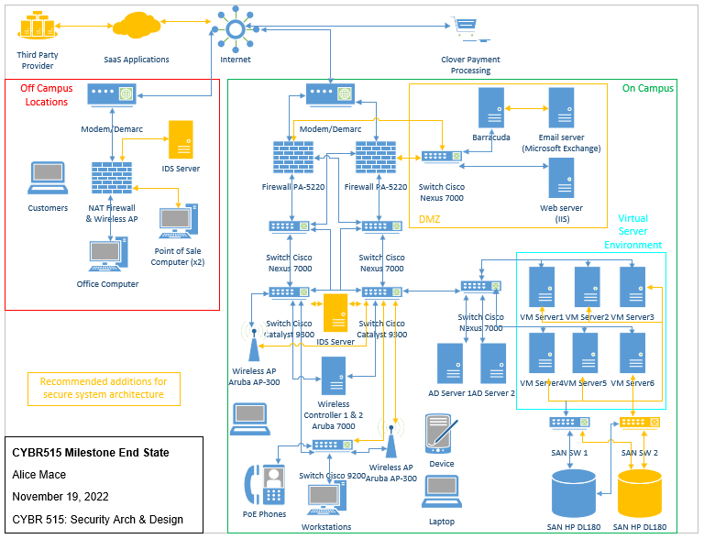
Recommended System Architecture
Notes:
This diagram represents the recommendations to your architecture with the changes in orange
There are many features that would be a policy or process change that also substantially assist in network security that we’ll detail on the next slide
Some of these recommendations do not require new hardware but are new connections to provide redundancy in case one component fails
The top left two orange figures are not hardware but represent software as a service functions (like email and data storage) provided by a third party
We also recommend instilling a DMZ encompassing the elements depicted in the orange box for separation and enhanced security
There are 4 recommended pieces of new hardware:
2 IDS Servers (for on and off campus locations) to inform the IT team when an intrusion is occurring and allow them to better mitigate potential breaches
Secondary SAN for redundancy and enhanced storage
Switch to connect the second SAN to the VM servers

Slide 5

Recommended Policies
Firewalls
Authentication
Physical Access Restrictions
Password Requirements
Privileged User Accounts
Updated Software
Anti-virus/Anti-malware
Security Policy
CIRT
Audit Records
Notes:
Firewalls
All firewalls should serve as a security measure and prevent activity on the network from affecting other network components, its recommended to enable the firewall to scan data going to and from the network.
The Barracuda system relocated to offer a secure connectivity for the web and email servers, as depicted in the diagram.
Authentication (Security Policy)
The firewall controls for the mobility controllers for wireless access points, but they will also be linked with the active directory servers to require users’ logon with their credentials before network access is granted.
The wireless network current has open logon access but should require login with employee id number and password, at a minimum, but two factor authentication with an RSA token would be preferred to better verify personnel credentials. This can be used for company or personal devices to that the current Bring Your Own Device policy can still withstand.
there are several risks with a Bring Your Own Device policy and it is recommended to create a security policy with access limitations and use policies, for instance, policies that allow for monitoring of certain device activities when connected to the network and same or similar access restrictions as other hard-wired devices.
Physical Access Restrictions
For the wired network infrastructure, there are communication closets with patch panels that could allow network administrators to manually bypass a defective switch. Access to these closets should be strictly limited to prevent unauthorized access to the switches and modification of any hardware/software.
Password Requirements
The Active Directory domain controllers were configured using default settings and the password history and complexity requirements were disabled. It’s recommended to enable these functions and require password updates every 90 days, at a minimum, and ensure complexity requirements
Privileged User Accounts
There is a second Active Directory Organization Unit for the Accounting and Finance Group currently allows all administrative assistants to be administrators in order to quickly add or remove user accounts. To limit the number of people with full access and potential vulnerabilities or misuse, its recommended to make only 1-3 people administrators, dependent on the size of the Accounting and Finance group.
About 1/3 of employees have local administrator access for the +400 workstations in order to install and run applications. This large group makes it more likely for someone to install or configure something harmful to the network, intentionally or unintentionally. It’s recommended to make only 5-10 people administrators, dependent on size of group supporting, to limit the number of people with full access and limit vulnerabilities.
Updated Software
The virtual servers currently do not have antivirus software installed. It is suggested that antivirus software be installed to prevent any malicious software that could get introduced to the system by insider threats or file transfers to the virtual machines.
Ensuring the firmware on the Storage Area Networks are up to date is also important, as the latest update was from 2018.
Anti-virus/Anti-malware
A vulnerability was also created by allowing the point-of-sale software to be minimized, which resulted in those computers getting malware. To mitigate this concern, J&L should install anti-malware software and change settings so that the point-of-sale software cannot be minimized.
Security Policy
A security policy should also detail how and when program updates, patches, or upgrades will be installed by the IT group/system administrators. This policy should also address how passwords should be handled, as a huge vulnerability currently is employees writing down their passwords and keeping it at their desk, sometimes in view when approached
The implementation of Information Security Continuous Monitoring (ISCM) processes and instilling the risk management framework for all system architecture components is one step J&L should take to keep their systems and personnel functioning properly.
CIRT
A Computer Incident Response Team (CIRT) and CIRT plan should also be established which encompasses policies and procedures to follow in the event of an attack and identifies individual’s roles in the response. This team can quickly react to an attack and establishing a CIRT plan helps an organization focus on the critical business functions and restoration of those services first.
Audit Records
Another key piece of data that will be recorded on J&L’s servers are auditing records. This helps to establish when, where, and how an attack took place or a virus entered the system. It is also critical when addressing an insider threat concern and being able to track back to an individual based on their login credentials who may be responsible.
Companywide compliance and monitoring are necessary components to a successful security architecture and must be enforced through policy and leadership, even when not convenient.

Slide 6
Services & Contact Details
Mace Network Security Services
Security Evaluations
Improvement Recommendations
Upgrades/Installation
Maintenance
Policy Drafts & Reviews
Alice Mace – Consulting Officer
Phone: 555-555-5555
Email: mace@security.net
Website: www.macenetworksecurity.com
Notes:
Sales pitch
Closing statements
Thank for opportunity

